Slide 1
Lecture 29
Node.js

Slide 2
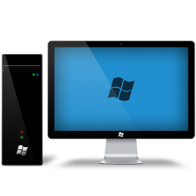

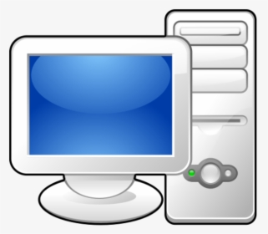
Connecting your app to the public
PROJECT
USER 1
USER 2
USER 3
USER 4
USER 5

Slide 3
We need a networking protocol for connecting between multiple machines with different Operating systems
A protocol is a set of rules which both sides required to be able understand to allow communication between them.
PROJECT
HTTP is an application-layer protocol that is used for transferring files on the internet. It is used by web browsers and servers use to communicate.
USER 4
USER 5

Slide 4
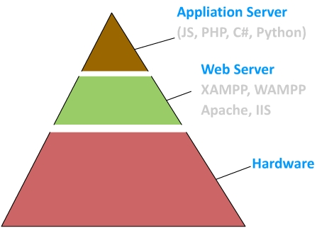

Slide 5
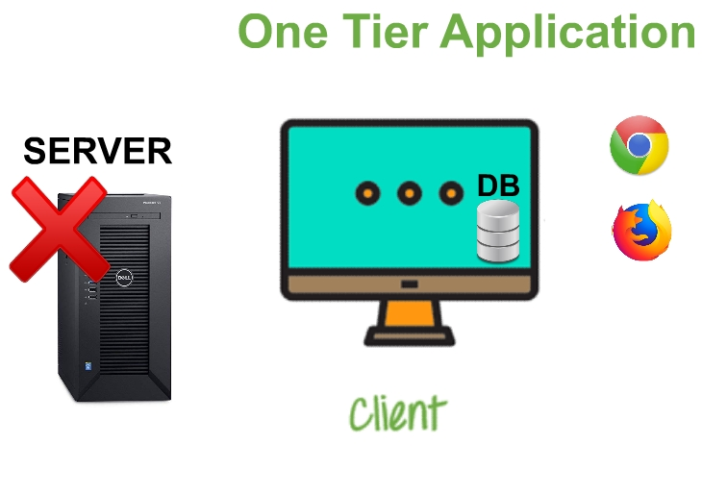

Slide 6
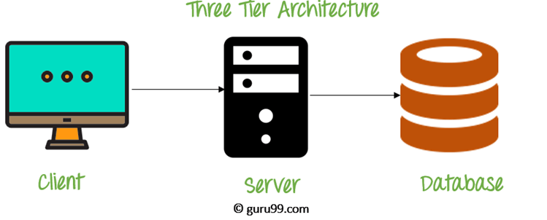

Slide 7
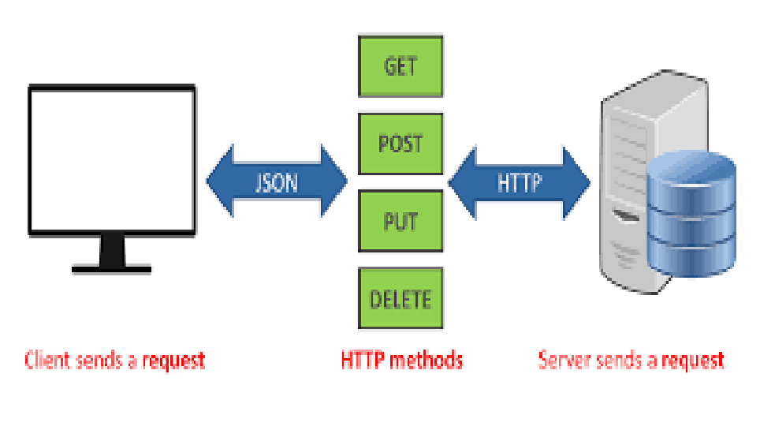

Slide 8
Why Node.js?
More optimized code execution (Just-In-Time compilation)
Can handle as much as twice requests as compared to PHP
Consumes much less RAM and CPU resources as compared to its counterparts.

Slide 9
Why Nodejs Beats?
Node.js uses an event-driven, non-blocking I/O model that makes it lightweight and efficient.

Slide 10
Why Nodejs Beats?
Non-blocking means the code execution does not stop on an external operation. Instead it moves on and keeps a reference place for the expected response. PHP Code
$result = $conn->query(‘select * from students’);
//The server will wait until the result returns,
Node.js Code
conn.query(‘select * from students’, function(){
});
//System will move to the next lines without waiting for the result

Slide 11
Synchronous and Asynchronous Functions
Synchronous program execution happens once at a time. A program does not move forward until its frees from previous work.
Asynchronous program execution happens without any interruption. A program moves forward without waiting for the previous work.

Slide 12
Is It Beneficial For Us? (The JS Developers)
Built-in server support
A single syntax for client and server side of the website. This improves the reusability of the code and makes the work of a full stack developer easier
Module caching – modules are downloaded and initialized when they are called for the first time, afterward they are constantly available
Stream module makes it easier to work with large files
Node has an almost identical syntax to JavaScript, thus it easy to pick-up and learn for JS developers

Slide 13
Lets get started!
Modules
Importing Modules
Setting up Server

Slide 14
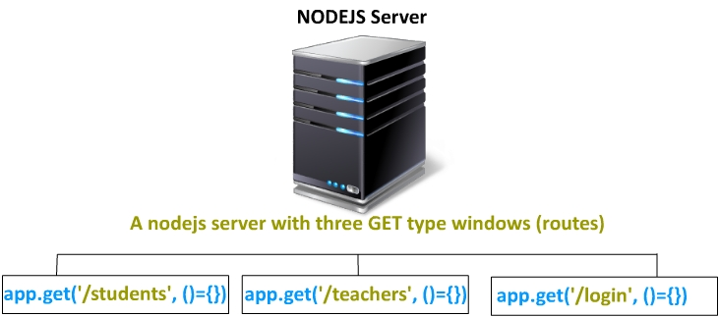

Slide 15
Modules
Modules allow us to organize all our code in separate independent pieces which promotes code reusability and easily maintainable codebase.
Example>
var myFileSystem = require(‘fs’);

Slide 16
CommonJS Module System
All exposable code should be attached to the exports variable
Example> calculator.js
function add (a, b) {
return a + b
}
function substract (a, b) {
return a + b
}
module.exports = add; //Subtract function will not be exported as it has not been attached with the exports variable.

Slide 17
CommonJS Module System
Importing calculator.js
var addFunction = require(‘./calculator’);
addFunction(2, 5);

Slide 18
CommonJS Module System
We can also attach a function to the export variable.
Example>
module.exports = function(){
return {
addNumbers:add,
subtractNumber:subtract
}
}

Slide 19
Setting Up a Basic Server with Node.js
http and https modules are used for setting up servers in Node.js
var http = require('http');
var myServer = http.createServer();
myServer.listen(7070);

Slide 20
Setting Up a Basic Server with Node.js
We need a handler function to receive and response to incoming requests.
http.createServer(function(request, response){
});
//request object contains all the information from the request client
//response The answer object that the server gives back to the client

Slide 21
Using More Robust Frameworks
Though we can use http module to create our own servers, but there are more robust and efficient frameworks available in the market.
Our target web application framework> Express.js
http://expressjs.com

Slide 22
Understanding Request Points
A Request Point refers to a specified route on the server (Not in all cases).
Request points allow us to respond us according to the request type.
Example>
/students/add
/teachers/lectures
/admin/notificationsform

Slide 23
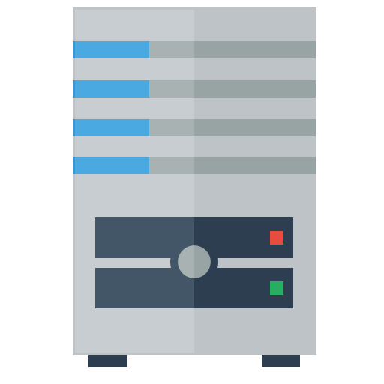

Designing Request Points
Jquery> $.get(‘students/20’, function(data){ //data });
Fetch> fetch(‘students/20’).then(function(resp){ //resp })
/students/:tID
Node.js> app.get(‘/students/:tID’, function(req, res){ res.end(20);
})

Slide 24
Understanding Middlewares
Middlewares allow us to inject our own layers in the application flow execution.
This provides us a greater flexibility in integrating our external logics and other stuff along with the core framework.

Slide 25
Understanding Middlewares
Middleware allows you to define a stack of actions which are interconnected together and that we should flow through.
Express servers themselves are a stack of Middlewares.

Slide 26
Understanding Middlewares
app.use(function(req, res, next){ next(); })
Layer 1
app.use(function(req, res, next){ next(); })
Layer 2
app.use(function(req, res, next){ next(); })
Layer 3

Slide 27
Thank You

